Slide 1
Root Solving 1: Bisection Method
AMSC/CMSC 460
Dr. Christopher Moakler

Slide 2
What is a root?
A root is the solution to an equation of the form $f\left(x\right)=0$.
The form of the function $f(x)$ can be a simple linear equation or a transcendental equation.
Ex. 1 $f\left(x\right)=x^{2}+x+1=0$
Ex. 2 $e^{x}−10x=0$
This may seem limiting. But, realize equations of the form $f\left(x\right)=g(x)$ can be rewritten as $h\left(x\right)=f\left(x\right)−g\left(x\right)=0$
This opens up the kinds of questions we can seek to answer.

Slide 3
How does a computer see a root?
It is very unlikely that a computer will evaluate a function to be precisely zero.
Generally due to floating point issues.
So how can we expect a computer to find a value of $x$ s.t. $f\left(x\right)=0$?
Typically, we do not need an exact answer nor do we expect a computer to provide.
The best they are capable of is providing an interval in which a root exists.
It is very easy to determine whether a root exists in an interval by looking at the sign of the function at the interval’s endpoints.

Slide 4
Why do we want to find roots?
People have sought the roots of equations since antiquity.
They did not write them in the way we do.
They typically wrote them as word problems.
In modern mathematical jargon, they are often simple linear equations.
For example, see the Rhind Papyrus.
Even today we often want to find the roots of a given equation.

Slide 5
Take roll!

Slide 6
Let’s play a game!
I’m thinking of a number between 1 and 100.
For every guess, I will tell you if you are high or low.
What is the minimum number of guesses required to determine my number?
Trick question! It’s one. If you guess right on the first try you did still find my number.
What is the minimum number of guesses that guarantees you find my number?
The minimum number is 7.
How?

Slide 7
Let’s actually play it now.
For every guess you make, I tell you if it’s high or low.
Your initial guess should “50” as this allows us to remove half of the possible numbers immediately.
Depending on whether you were high or low, you should again pick the midpoint to further halve the possible answers.
After repeating this procedure for 7 guesses, we have eliminated all but the final answer.
This process is slow, but sure to converge.

Slide 8
The Bisection Method
The Bisection(Bracketing) Method is essentially this process.
We must assume the function is continuous and relatively well behaved.
An initial guess is provided in the form of an interval, $[a,b]$ where a root might exist.
We find the signs of $f(a)$ and $f(b)$
If they are different, the intermediate value theorem guarantees the existence of a root
If not, we need a better guess.

Slide 9
The Bisection Method Algorithm
Given an initial interval $[a,b]$, we calculate $f\left(a\right)f(b)$ and determine whether it is positive or negative.
$f\left(a\right)f\left(b\right)>0$, we can not guarantee a root exists within the interval and we need a new guess.
$f\left(a\right)f(b)<0$, there is a zero in our interval and we can continue.
We halve our interval at the midpoint, $c= \frac{a+b}{2}$.
$f\left(a\right)f\left(c\right)<0$, we set b = c and continue the algorithm.
$f\left(b\right)f\left(c\right)<0$, we set a = c and continue the algorithm.
When this algorithm terminates, it provides an interval containing a root, we generally assume the root is $\frac{a+b}{2}$.

Slide 10
Accuracy and Speed
At every step we halve the size of the interval containing the zero.
After n steps, the interval has length, $\frac{(b−a)}{2^{n}}$.
Thus, the error, the difference between our estimate and the true root, is,
$|x_{c}−x_{0}|$ < $\frac{(b−a)}{2^{n}}$
This took $n+2$ function evaluations.
This exact definition of the error at every step is not typical for most algorithms.
We need other ways to know when to stop.

Slide 11
When do we stop?
One of the hardest questions we have to answer as computationalists is, when to stop?
Well, when do we tell the computer to stop. We’re typically watching tv while the computer works.
This will come up time and time again.
We have several issues that affect our answer:
How accurate of an answer do we want?
How much time can we dedicate towards the algorithm?
How long can we hide our script from the IT folks?

Slide 12
When do we stop?
Typically, our answer will be set by the desired tolerance.
If we need to know the answer to the n^{th} decimal place, there’s not always much we can do about that.
However, sometimes you can only run your code on a computer cluster for a set amount of time and you need to make sure your code returns in that time.

Slide 13
Tolerance
At every step of our algorithm, we should be getting closer to the “true” answer.
When our approach to this “true” answer begins to slow, we want the algorithm to return.
For example, in the bisection method, we would want to terminate when $\frac{b−a}{2}<tol$.
We could similarly tell the algorithm to terminate when $f\left(\frac{b+a}{2}\right)<tol$.

Slide 14
Algorithm Termination
In theory, you would write your code with a while loop,
while $\frac{b−a}{2}>tol$
Bisection algorithm
end.
However, due to other considerations, I typically use a for loop,
for i = 1:nstepmax
Bisection algorithm
end.
This prevents the code from getting stuck in an infinite loop due to a bug.
It also forces the code to return if you set your tolerance too low.

Slide 15
Algorithm Termination
Expect your code to fail in unexpected ways.
You may not realize what part of your code will cause its execution to properly return.
Your computer may inadvertently shutdown before the code returns.
The computer cluster your using my go offline for unannounced maintenance.
Your laptop battery might die.
Your computer may decide you need to update RIGHT NOW!
For “important” code you should frequently save your progress to disk.

Slide 16
Ad hoc today, indispensable tomorrow
When we write code to model or simulate it is very tempting to forego good coding practices.
Always comment your code! It may seem obvious to you now, but it won’t in a month.
Perform proper parameter checking. E.g., if a value has to be between 0 and 1, make your code check that and inform you if the value isn’t.
Institute “try catch” statements if applicable
What seems like ad hoc code now may become code you want to use every day.
MAKE IT GOOD CODE!

Slide 17
Fixed Points
What is a fixed point?
A fixed point is a solution of an equation of the type $f\left(x\right)=x$.
For example, take out your calculator and evaluate $cos⁡(0.5)$
cos(0.5) | 0.8775825619
cos(0.8775825619) | 0.6390124942 | cos(0.7300810631) | 0.7451203414
cos(0.6390124942) | 0.8026851007 | cos(0.7451203414) | 0.735006309
cos(0.8026851007) | 0.6947780268 | cos(0.735006309) | 0.7418265226
cos(0.6947780268) | 0.7681958313 | cos(0.7418265226) | 0.7372357254
cos(0.7681958313) | 0.7191654459 | cos(0.7372357254) | 0.7403296519
cos(0.7191654459) | 0.7523557594 | cos(0.7403296519) | 0.7382462383
cos(0.7523557594) | 0.7300810631 | cos(0.7382462383) | 0.7396499628

Slide 18
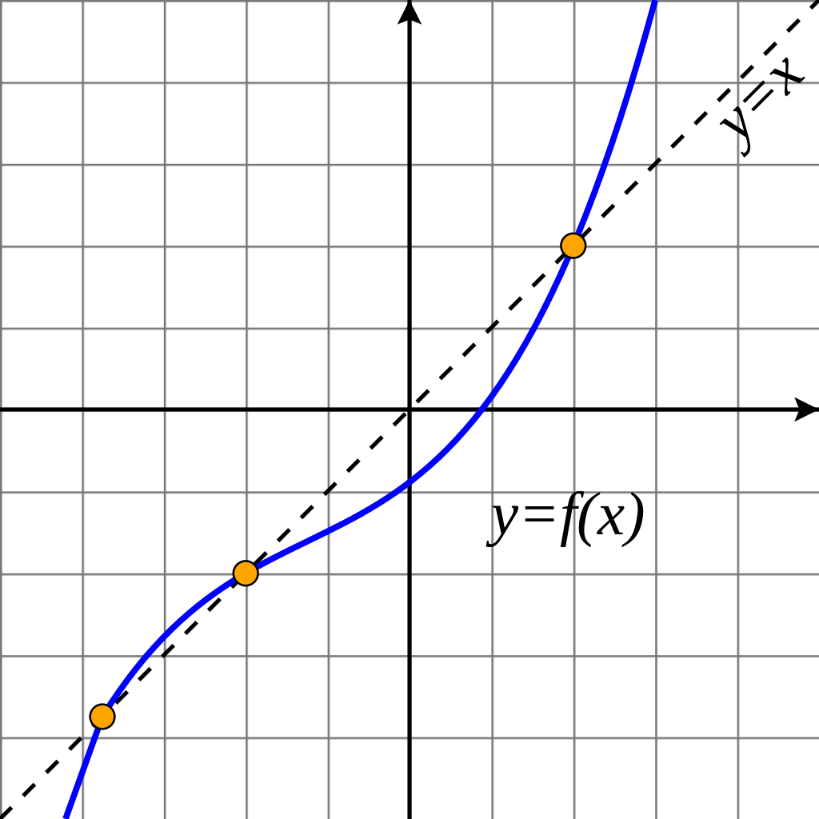
Fixed Points
A fixed point of $\cos\left(x\right)=x$ is $≈\text{0.73908}\text{51332}$.
Other expressions have other fixed points and might have multiple.
For example,
This would have 3 fixed points
https://commons.wikimedia.org/wiki/File:Fixed_point_example.svg

Slide 19
Why do we care about fixed points?
Any equation of the form $f\left(x\right)=0$ can be rewritten as a fixed point equation, e.g. $g\left(x\right)=x$.
Take for example the function,
$f\left(x\right)=x^{3}+x −1=0$
We can rewrite this into a fixed point equation in several ways
$g_{1}\left(x\right)=1−x^{3}=x$
$g_{2}\left(x\right)=\sqrt[3]{1−x}=x$
$g_{3}\left(x\right)=\frac{1+2x^{3}}{1+3x^{2}}=x$

Slide 20
Fixed Point Iteration
We can solve the cosine fixed point using the bisection method on the function $\cos\left(x\right)−x=0$.
However, we can also write code to automate the iterative process for us.
We take an initial guess, input it into the function, and use the output as the input on the next iteration.

Slide 21
Fixed Point Iteration Algorithm
$x_{0}=rand$ %Random initialization
for i = 1:nstepmax
$x_{i+1}=g\left(x_{i}\right)$
end
This one is pretty simple to implement

Slide 22
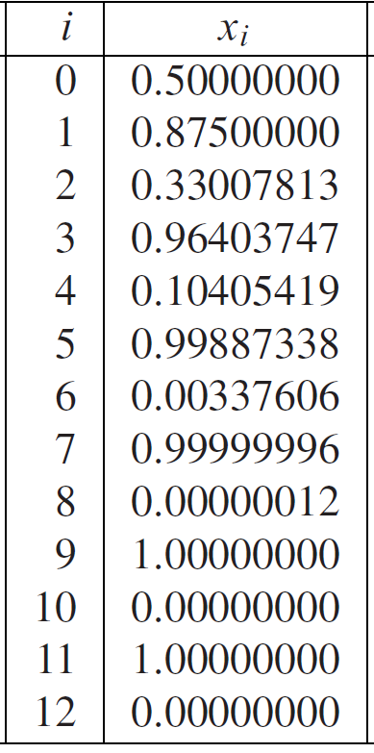
When FPI fails
There are times when FPI does not converge.
Let’s look at the three choices when $f\left(x\right)=x^{3}+x−1=0$
$g_{1}\left(x\right)=1−x^{3}=x$
$g_{2}\left(x\right)=\sqrt[3]{1−x}=x$
$g_{3}\left(x\right)=\frac{1+2x^{3}}{1+3x^{2}}=x$
For the first choice we get the
loop on the right.
This does not converge
Sauer

Slide 23
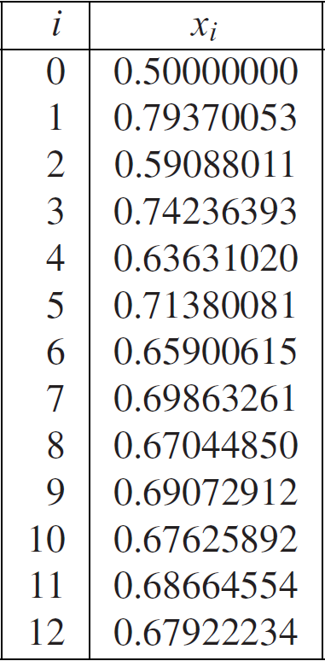
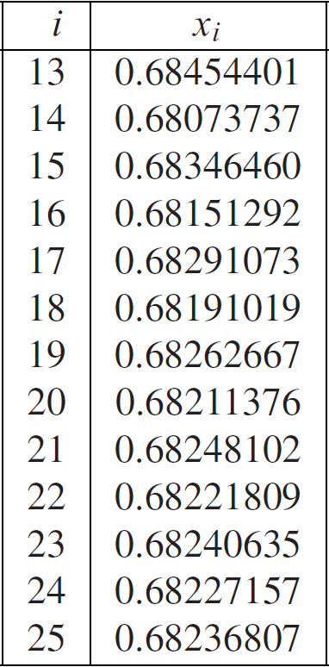
When FPI is slow
For the second choice, $g_{2}\left(x\right)=\sqrt[3]{1−x}=x$, we get,
Sauer

Slide 24
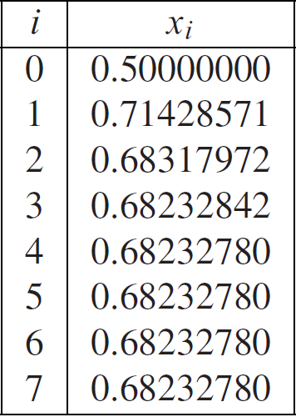
When FPI is fast
The third choice, $g_{3}\left(x\right)=\frac{1+2x^{3}}{1+3x^{2}}=x$, yields,
Sauer

Slide 25
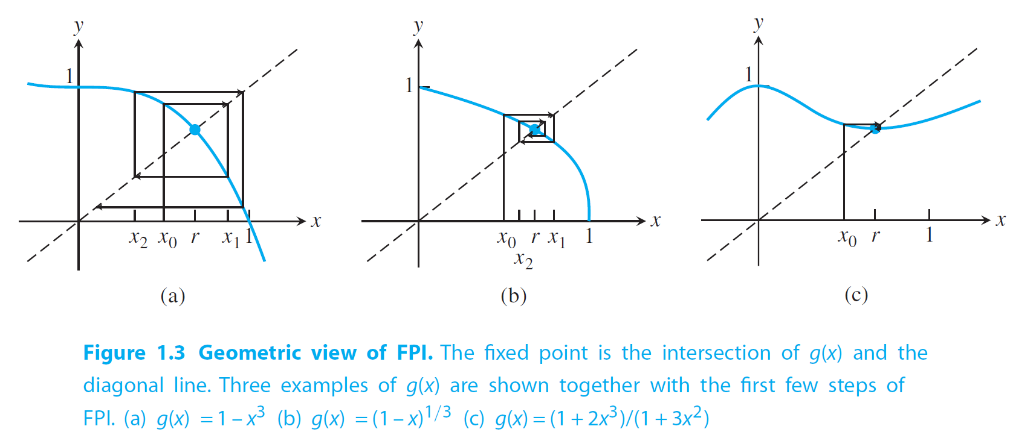
The geometry of the problem
Sauer

Slide 26
Convergence of FPI
If $g$ is continuously differentiable, and the value of the derivative at the fixed point, $x_{f}$, is less than 1, then FPI converges.
If $S=\left|g^{′}\left(r\right)\right|<1$ then FPI converges linearly at the rate, S.
That is,
$\lim_{n→∞}{\frac{e_{i+1}}{e_{i}}}=S$
A method is locally convergent if the initial guess is sufficiently close to the solution, the method converges to that solution.
FPI is locally convergent if $\left|g^{′}\left(r\right)\right|<1.$

Slide 27
When do we stop?
FPI is an example of an algorithm that might not converge.
It can converge linearly or oscillate infinitely.
It might even lead to an overflow.
You must impose a stopping criterion.
Typically, we use something like,
$\left|x_{i+1}−x_{i}\right|<TOL$
We might instead prefer a relative stopping criterion,
$\frac{\left|x_{i+1}−x_{i}\right|}{\left|x_{i+1}\right|}<TOL$
You should always impose a maximum number of iterations to avoid infinite loops!

Slide 28
Summary
The bisection method is guaranteed to converge linearly.
Fixed point iteration might not converge, if it does, it is locally convergent and the local convergence is only linear.
Sometimes the bisection method is faster than FPI, sometimes not.
Both methods are outclassed by Newton’s Method and others.
These examples are largely pedagogical.
Though the bisection method does see use.

